Slide 1
Punchout Demo

Slide 2
Punchout – 2 types
Punchout Level 1: allows you to access a supplier catalog from Ivalua and perform your purchases on the external catalog. Once you validate your shopping cart on the supplier site, the items of your shopping cart are added to your requisition in IVALUA.
Punchout Level 2 (Search 360): in addition to a punchout access, a list of items available on the punchout catalog is also hosted directly in the built-in IVALUA catalog (list defined by the buying company and the supplier). When the user performs a search in the built-in catalog, the items of the suppliers enabled for the PunchOut Level 2 are included in the search result. The user can then either add those items to his cart directly in IVALUA or they can access the supplier external catalog by using a punchout link available on the item sheets. From the supplier site, the user can purchase items as within Level 1 Punchout.

Slide 3
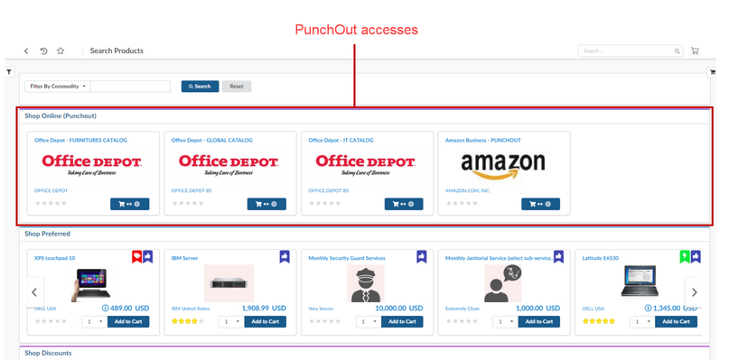
Punchout - Accessing
You may access:
PunchOut catalogs that are linked to the legal company you are assigned to
(or linked to a template legal company that serves as a base for your assigned legal company)
PunchOut catalogs that are not linked to any legal company (accessible to all)
Users who have been granted the below authorizations are not subject to these restrictions:
[ACCES] View punchouts of all legal companies - auth_pdt_browse_all_comp_pun
PunchOuts accesses are available from the Shop > Search Products.
They are materialized by the logos of the corresponding suppliers.

Slide 4
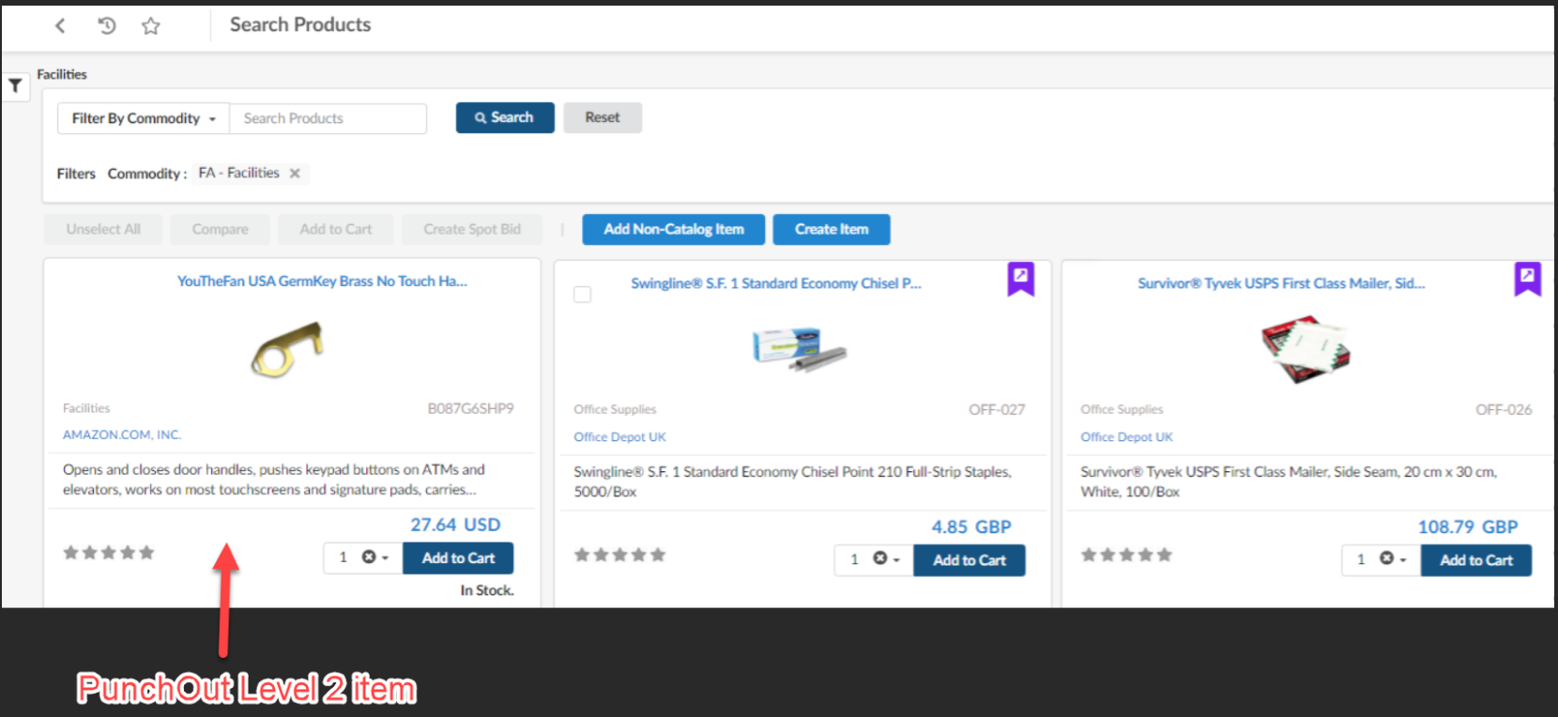
Punchout - Accessing PunchOut level 2
When you perform an item search in the IVALUA catalog, the search result contains the hosted items
of the suppliers enabled for the PunchOut Level 2.
The Level 2 PunchOut items look similar to the internal items.
Just like internal items, you can view, compare punchout items with other items of the search result
and add them to your cart (Add to Cart button).
The price and the availability of those items are updated automatically by the supplier platform via an API.

Slide 5
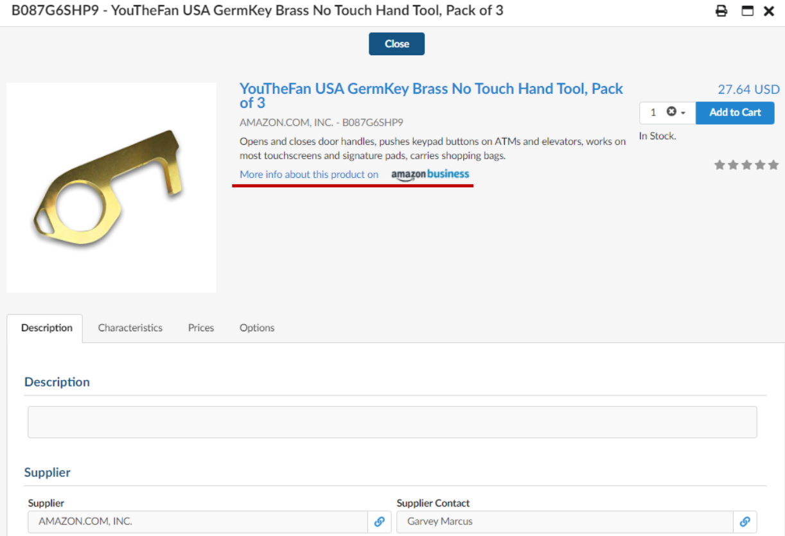
Punchout - Accessing PunchOut level 2
When viewing an item sheet, a punchout link allows you to access the same item in the supplier’s
external catalog.
This allows you to obtain more information on the same item or, for example, explore the supplier
site before adding items to your shopping cart.
The Level 2 PunchOut items look similar to the internal items:

Slide 6
Punchout – Need to send Purchase Order?
The punchout configuration can be split into 2 parts:
1/ Possibility to create a basket (Purchase Requisition) with items from the PunchOut
catalogue (with level 1 or 2 integration)
2/ Once Purchase Order is validated, possibility to send back the PO to the PunchOut supplier
(only cXML is supported by Ivalua)
Ivalua
User accesses
external catalog
Level 1 PunchOut
Ivalua
User item searches return items
from Level 2 PunchOut
Level 2 PunchOut
User adds items to basket
User adds items to basket
User validates basket
and goes back to Ivalua
User opens and validates PR
PR automatically created
PO automatically
created from PR
User creates PO from PR
PO validation
PO validation
Upon PO validation,
PO sent to PunchOut
Upon PO validation,
PO sent to PunchOut

Slide 7
Punchout - Considerations
Punchout Level 1 or Level 2?
Which Suppliers?
Which Legal entities / Contracting Organisations?
Note that punchout level 1 needs to be configured at least once to activate punchout level 2.
Subsequent punchouts for the same company (e.g. Amazon) can then be done at level 2.

